Slide 1
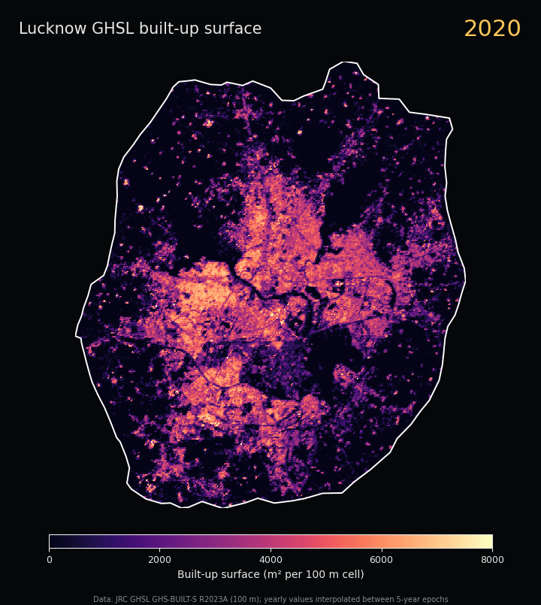
Built-up Surface Change in Lucknow, 2000–2020
Name: Yadvendra Singh Yadav
Roll no: CE25M414
Department: Civil and Environmental Engineering
Total vs predominantly non-residential built-up surface
JRC GHSL GHS-BUILT-S R2023A on Google Earth Engine
HS524M – Urban Informatics and Spatial Analytics |
Notes:
Title slide. This deck answers Question 2 for Lucknow (Row 9): compare changes in total built-up surface and predominantly non-residential built-up surface, using GHSL Built-up Surface for 2000–2020. The map on the right shows the 2020 built-up surface inside the Lucknow municipal boundary.

Slide 2
The question and what this deck delivers
Assignment requirement | Slides
City boundary and source | 4
Dataset, filters, method | 5–6
Indicator analysis and statistics | 7–10, 15, 17
Thematic maps (title, legend, units) | 11, 13, 14, 16
Dynamic temporal output | 12
Discussion and limitations | 18–19
Sources and hosting | 20
Research question
How did total built-up surface and predominantly non-residential built-up surface change in Lucknow between 2000 and 2020?
Sub-questions
Do the two grow at the same rate?
What happens to the non-residential share?
Where in the city did the growth happen?
Notes:
The assigned analysis is: compare changes in total built-up surface and predominant non-residential built-up surface (GHSL, 2000–2020). Required outputs are a time slider or GIF, total vs non-residential change maps or graph, and a discussion. The table on the right maps every assignment requirement to the slide where it is answered.

Slide 3
Summary of results: municipal area, 2000 to 2020
+22.7 km²
+0.66 km²
3.46 → 3.30%
20.0 → 28.2%
Total built-up surface (+40.9%)
Non-residential surface (+34.4%)
Non-residential share of built-up
Built-up share of city area
1
The municipal built-up surface grew from 55.4 to 78.1 km². Growth was fastest in 2010–15 (+6.7 km²) and slowed in 2015–20 (+4.3 km²).
2
Non-residential surface is small (about 3% of built-up) and grew more slowly. It supplied only 2.9% of the new built-up surface.
3
In the wider district, built-up surface doubled (74.7 → 152.2 km²) and 2015–20 was its largest interval, so growth is moving beyond the city limits.
Notes:
Headline numbers for the Lucknow Municipal Corporation polygon (277.3 km2). Total built-up surface grew 40.9 percent. Non-residential built-up surface grew 34.4 percent, slightly slower, so its share of built-up surface slipped from 3.46 to 3.30 percent. Built-up surface now covers 28.2 percent of the city area, up from 20.0 percent. The district-level growth is much larger and is discussed on the later slides.

Slide 4
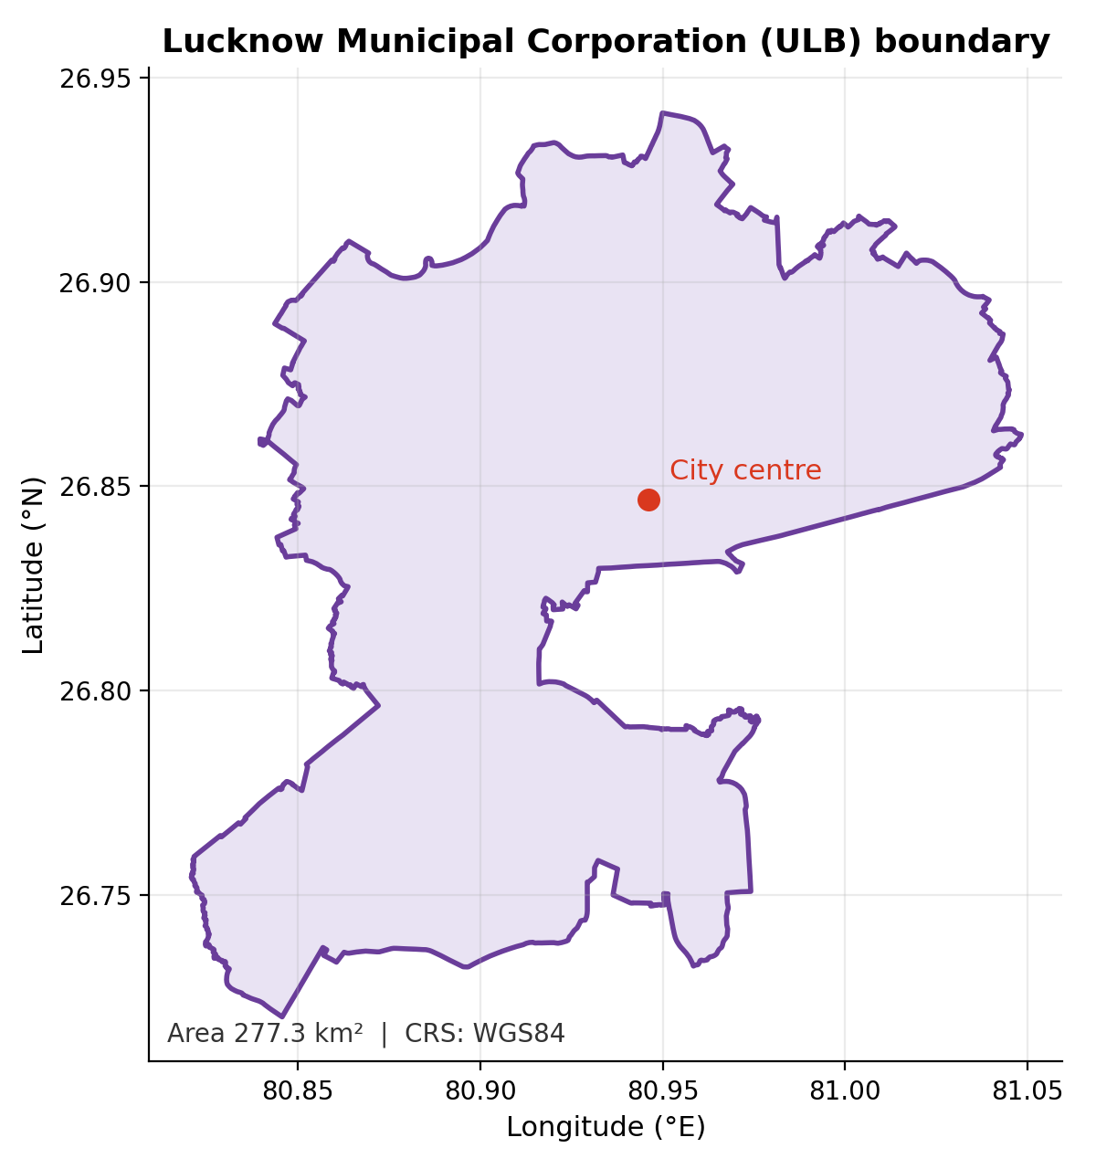
Study area and boundary
Main boundary: municipal area
Lucknow Municipal Corporation, 277.3 km². Indian Urban Local Body boundaries (SBM / DataMeet release, CC0).
Context boundary: district
Lucknow district, about 2,530 km². FAO GAUL 2015 level 2 via Earth Engine. Shows growth outside the city limits.
Preparation
GeoDataFrame → dissolve → WGS84 → make_valid → Earth Engine FeatureCollection
Notes:
The main analysis uses the Lucknow Municipal Corporation polygon from the Indian Urban Local Body boundaries (Swachh Bharat Mission data, released by ramSeraph / DataMeet under CC0). Its area is 277.3 km2. The file was filtered to the Lucknow M.Corp row, dissolved to one polygon, reprojected to WGS84, repaired with make_valid and converted to an Earth Engine FeatureCollection with geemap. The FAO GAUL 2015 district polygon (about 2,530 km2) is used only for context, to see growth beyond the city limits. The two boundaries come from different sources, so city and district results are compared but not simply added.

Slide 5
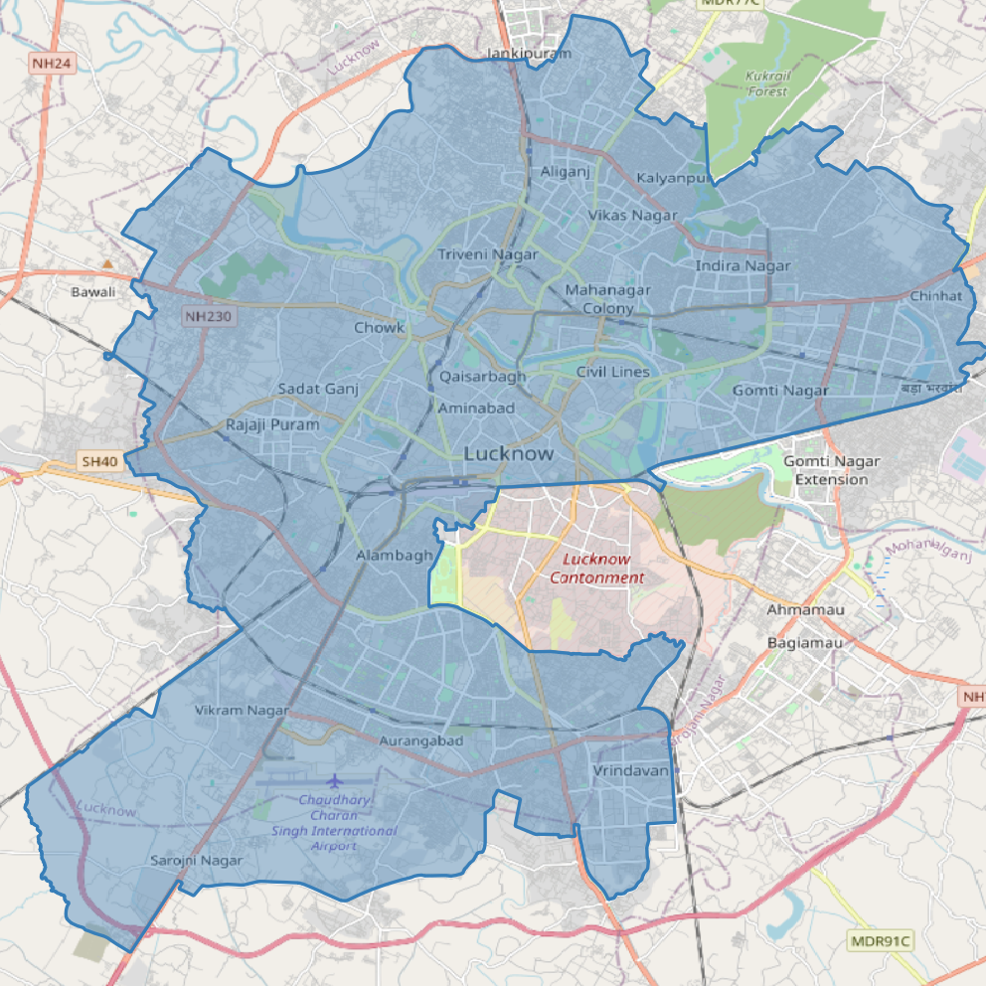
Data and boundary
JRC GHSL GHS-BUILT-S R2023A (100 m, 5-year epochs)
JRC/GHSL/P2023A/GHS_BUILT_S
built_surface: total built-up (m² per cell, 0–10,000); built_surface_nres: non-residential part
Residential = total − non-residential (residual)
City polygon (OpenStreetMap): about 277 km²
District polygon (FAO GAUL 2015, level 2): about 2,530 km²
Both analysed: the city polygon is the main result, the district shows the wider area

Slide 6
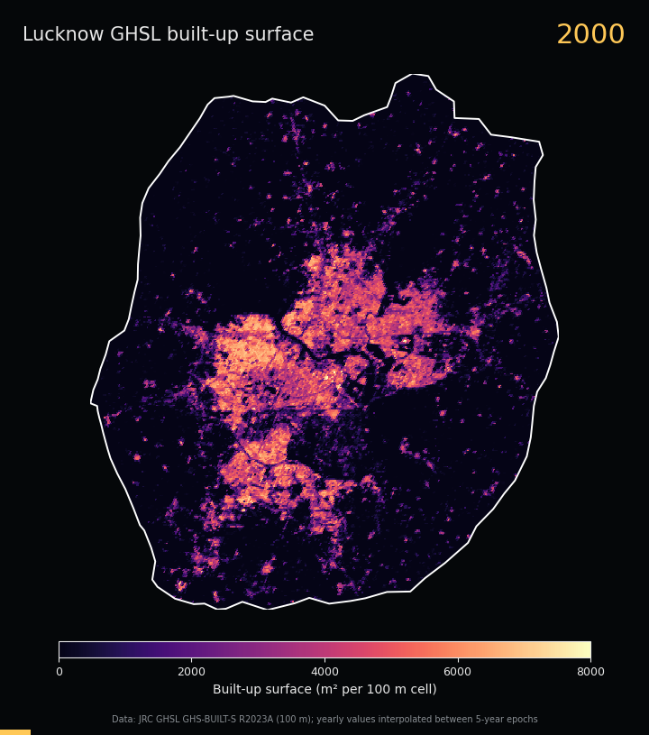
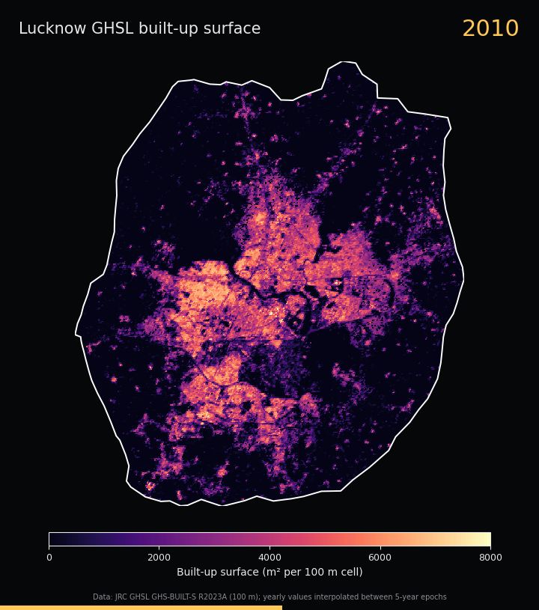
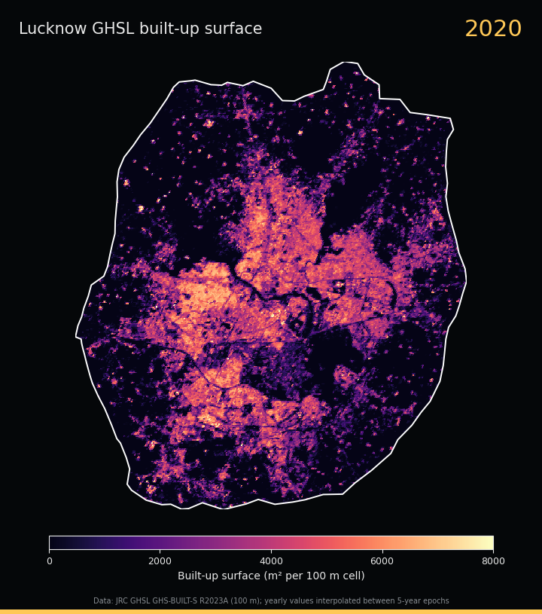
Dynamic output: built-up surface through time
Yearly animation 2000–2020 (GIF; yearly values interpolated between 5-year epochs) and an HTML player with year slider
Leaflet time slider on OpenStreetMap; both are on the project webpage. Colour scale 0–8,000 m² per 100 m cell

Slide 7
Dataset: GHSL Built-up Surface
Item | Value
Earth Engine ID | JRC/GHSL/P2023A/GHS_BUILT_S
Resolution | 100 m grid
Epochs used | 2000, 2005, 2010, 2015, 2020
Bands | built_surface, built_surface_nres
Unit | m² of built-up surface per cell (0–10,000)
Residential | total − non-residential (residual)
Aggregation | Sum inside boundary, scale 100 m
One 100 m cell (illustrative)
10,000 m² cell
Red: built_surface
Purple: part that is non-residential
Values are areas of built-up surface, not building counts. Cells can be partly built.
Notes:
GHS-BUILT-S R2023A estimates the built-up surface in square metres inside every 100 m grid cell, so the maximum value of a cell is 10,000 m2. built_surface is the total. built_surface_nres is the part of it in cells where the predominant use is non-residential. Residential surface is not provided directly, so it is computed as total minus non-residential, which makes it a residual that also contains any other uses. Epochs are every five years; the five used here are 2000, 2005, 2010, 2015 and 2020.

Slide 8
Method workflow in Google Earth Engine
1
2
3
4
5
Boundary
Load epochs
Prepare
Statistics
Outputs
Lucknow municipal polygon (277 km²) plus the FAO GAUL district for context; GeoDataFrame → Earth Engine geometry.
GHS_BUILT_S collection; one image per epoch: 2000, 2005, 2010, 2015, 2020.
Select built_surface and built_surface_nres; clip to the boundary; keep the native 100 m grid.
Sum m² inside boundary → km²; change, %, annual growth, shares, cell-level gain and loss.
Epoch maps, change maps, 2 km gain grid, GIF and HTML time slider.
Consistency rules: same five epochs everywhere; same colour scale across epochs (0–10,000 m² per cell); same ±3,000 m² scale for both change maps; every visual change backed by a number.
Notes:
Five steps in the notebook. The same filters and the same colour scales are used for every epoch so the maps are comparable. Statistics are sums of the 100 m cells inside the boundary, converted from square metres to square kilometres. No visual change is interpreted without a number next to it.

Slide 9
Built-up surface by epoch: municipal area
Year | Total (km²) | Non-residential (km²) | Residential (km²) | Non-res. share (%) | Built-up / city area (%)
2000 | 55.42 | 1.92 | 53.50 | 3.46 | 20.0
2005 | 60.58 | 2.08 | 58.50 | 3.43 | 21.8
2010 | 67.10 | 2.27 | 64.83 | 3.38 | 24.2
2015 | 73.78 | 2.47 | 71.31 | 3.35 | 26.6
2020 | 78.08 | 2.58 | 75.50 | 3.30 | 28.2
Total built-up
Non-residential
Residential / other (residual)
+22.66 km² (+40.9%)
+0.66 km² (+34.4%)
+22.00 km² (+41.1%)
Annual growth 1.73% per year
Annual growth 1.49% per year
53.50 → 75.50 km²
Notes:
Sum of GHSL built-up surface inside the municipal polygon. Total built-up surface rose in every epoch, from 55.42 km2 in 2000 to 78.08 km2 in 2020. Non-residential surface rose from 1.92 to 2.58 km2. Residential is the residual. Built-up surface covers 28.2 percent of the city area in 2020 compared with 20.0 percent in 2000.

Slide 10
Total built-up surface grew in every interval
Every epoch is larger than the one before: +22.7 km² in 20 years, an average of 1.13 km² per year.
Largest addition 2010–15 (+6.68 km²). Slowest 2015–20 (+4.30 km², +5.8%) compared with about +10% in the three earlier intervals.
Notes:
Left: total built-up surface by epoch. Right: the area added in each five-year interval. The largest addition was 2010–2015 at 6.68 km2 and the smallest was 2015–2020 at 4.30 km2, a growth of 5.8 percent compared with about 10 percent in earlier intervals. Inside the municipal boundary the pace therefore slowed after 2015.

Slide 11
Built-up surface by epoch: Lucknow city
Sum of GHSL built-up surface inside the city polygon (km²)
Year | Total (km²) | Non-residential (km²) | Residential (km²) | Non-res. share (%) | Built-up / city area (%)
2000 | 55.42 | 1.92 | 53.50 | 3.46 | 20.0
2005 | 60.58 | 2.08 | 58.50 | 3.43 | 21.8
2010 | 67.10 | 2.27 | 64.83 | 3.38 | 24.2
2015 | 73.78 | 2.47 | 71.31 | 3.35 | 26.6
2020 | 78.08 | 2.58 | 75.50 | 3.30 | 28.2
Residential is a residual (total − non-residential). GHSL values are modelled estimates on a 100 m grid.

Slide 12
Non-residential built-up surface is small and stable
1.92 → 2.58 km²
Non-residential surface (+34.4%)
3.46 → 3.30%
Share of built-up (−0.16 points)
2.9%
Share of all new built-up surface
The share barely moves: new built-up surface is almost entirely residential or other use.
Notes:
Predominantly non-residential built-up surface grew from 1.92 to 2.58 km2, which is 34.4 percent. Because total built-up surface grew faster, the non-residential share drifted down from 3.46 to 3.30 percent, a fall of 0.16 percentage points. Non-residential surface supplied only 2.9 percent of the new built-up surface between 2000 and 2020, and the interval shares were between 2.5 and 3.1 percent.

Slide 13
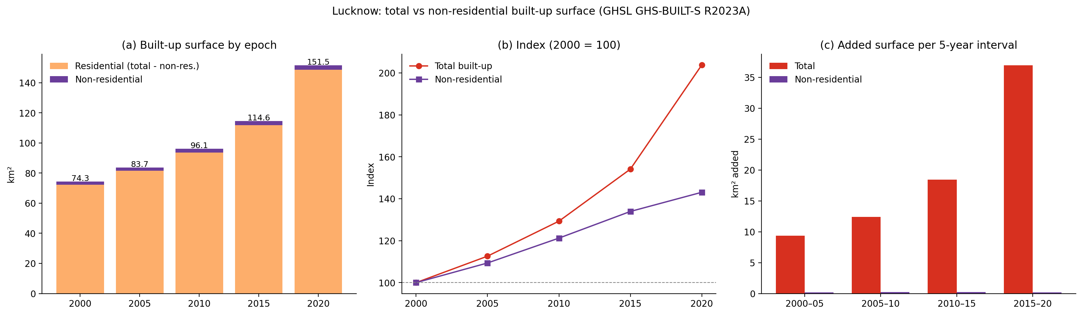
Wider area: Lucknow district
FAO GAUL 2015 district polygon (about 2,530 km²)
Total: 74.7 → 152.2 km² (+77.4 km², +103.6%, 3.62%/yr); non-residential: 2.03 → 2.92 km² (+0.89 km², +43.6%, 1.83%/yr)
Non-residential share fell from 2.72% to 1.92%

Slide 14
Total vs non-residential growth
Metric | Total | Non-res.
2000 (km²) | 55.42 | 1.92
2020 (km²) | 78.08 | 2.58
Change (km²) | +22.66 | +0.66
Change (%) | +40.9 | +34.4
Annual growth (%/yr) | 1.73 | 1.49
Index in 2020 | 140.9 | 134.4
Non-residential growth is 0.84 times the total growth (34.4% vs 40.9%).
Notes:
Index chart with 2000 equal to 100. By 2020 total built-up surface reached 140.9 and non-residential surface 134.4, so the lines diverge steadily. The table compares the two layers. Total built-up grew at 1.73 percent per year and non-residential at 1.49 percent per year. Non-residential growth is therefore about 0.84 times the total growth rate, measured in percent change.

Slide 15
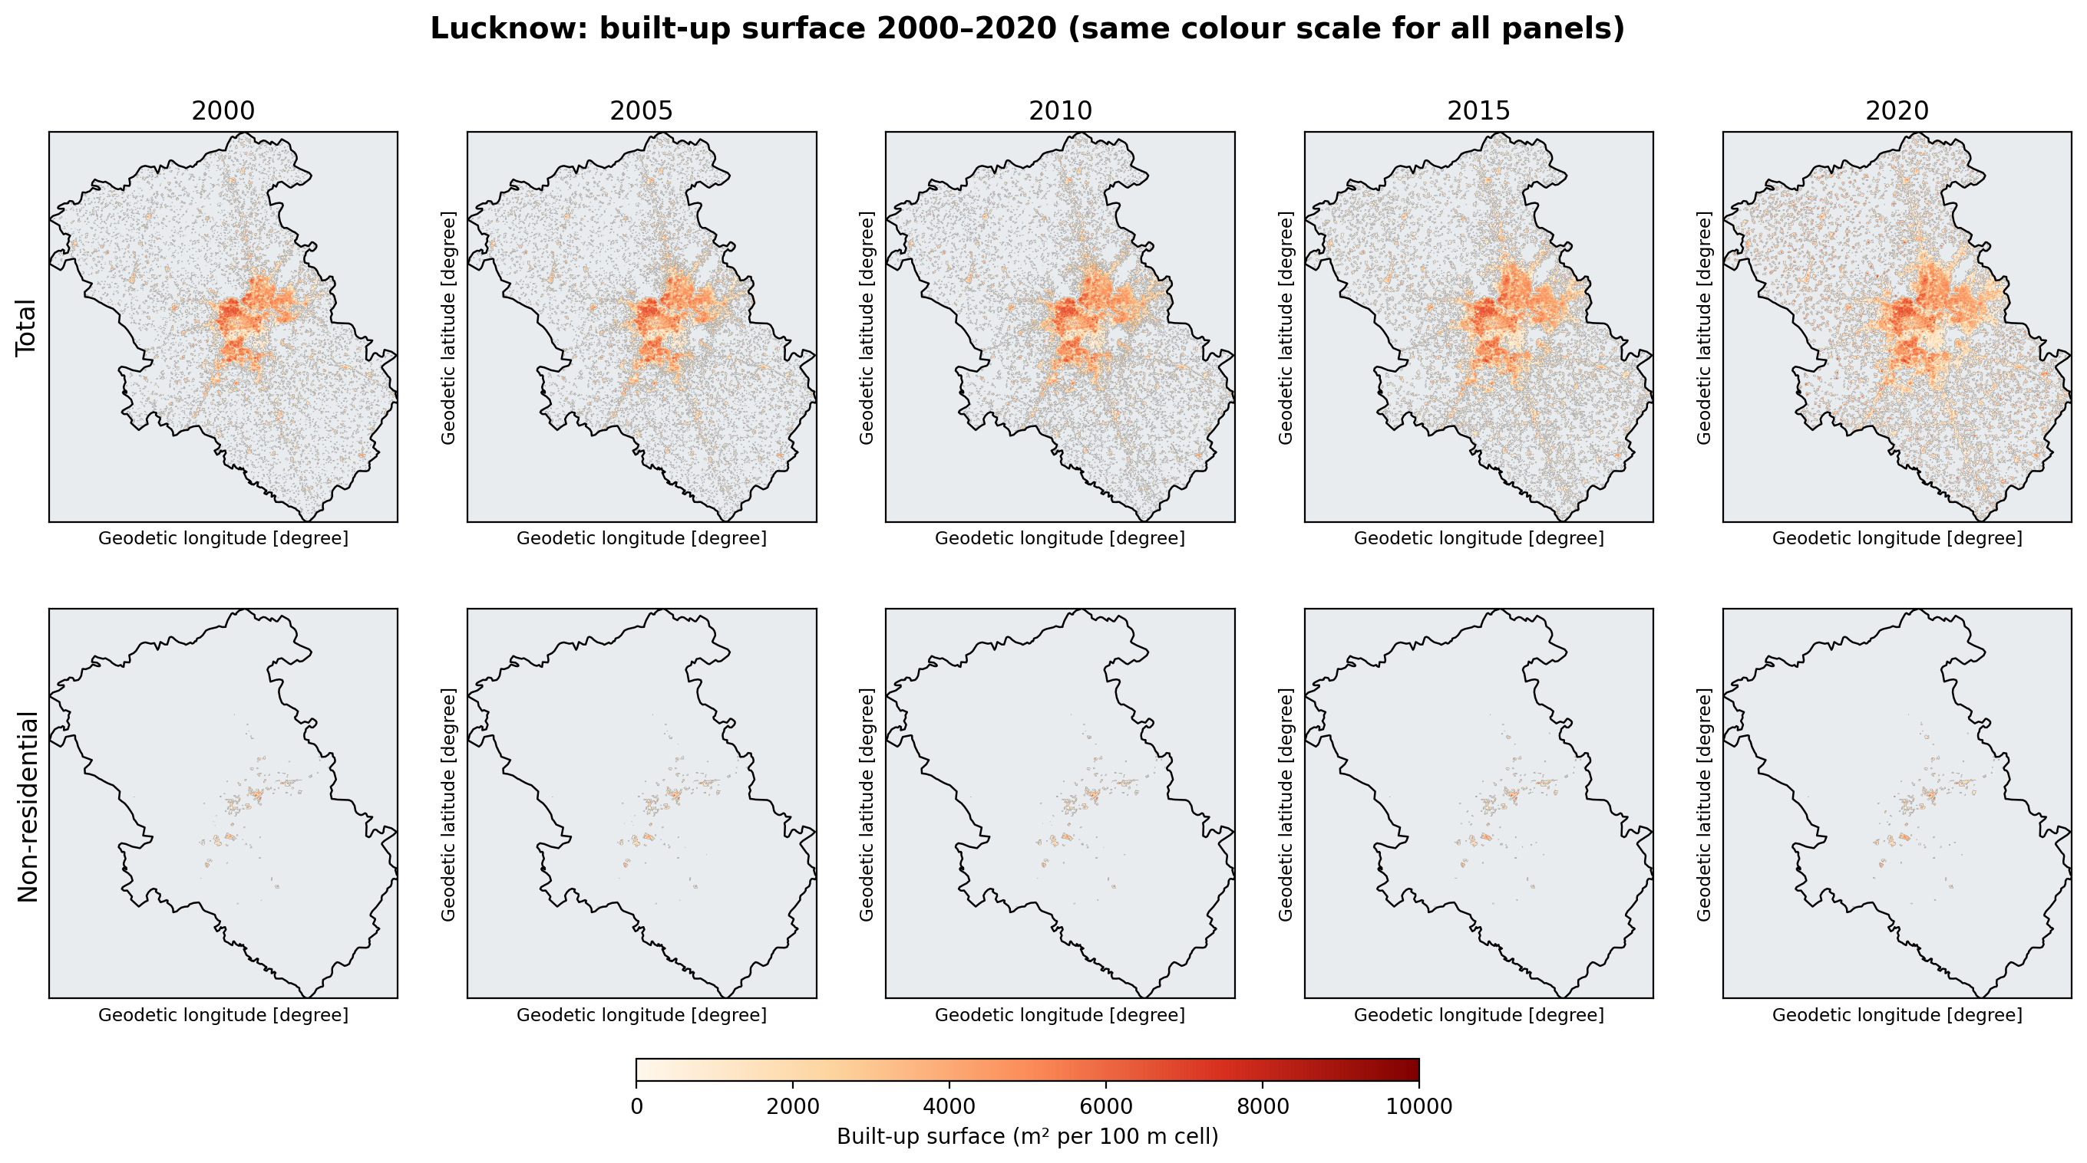
Built-up surface maps by epoch
District view (about 2,530 km²)
Same scale for all panels
Dense core already built in 2000
Spread outward after 2010
Non-residential: few clusters
Notes:
These maps show the Lucknow district (about 2,530 km2) so that the surrounding settlements are visible. Top row is total built-up surface and bottom row is non-residential, for 2000, 2005, 2010, 2015 and 2020. All panels use the same 0 to 10,000 square metres per cell colour scale. The dense core exists in 2000 and spreads outward, while villages and small settlements fill in across the district. The non-residential row stays sparse and concentrated near the centre.

Slide 16
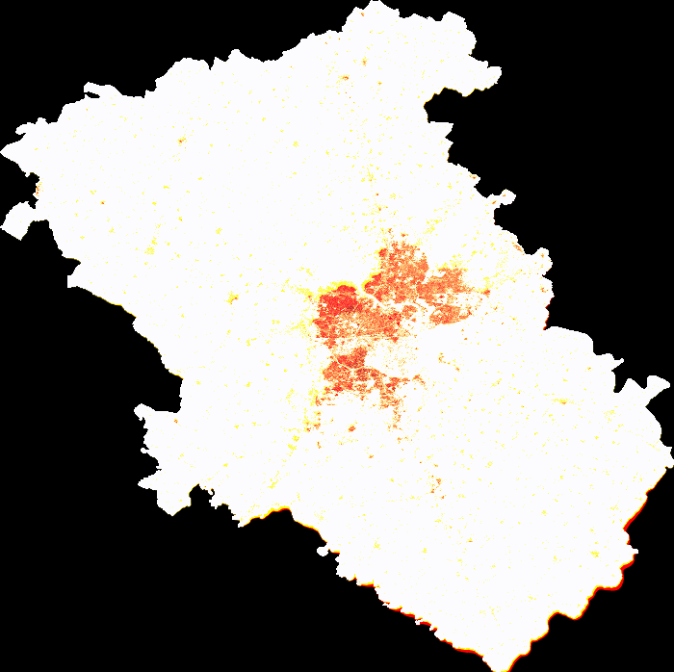
Dynamic output: built-up surface through time
1
Animated GIF
Five frames, 2000 → 2020, fixed colour scale. Shows the dense core filling in and settlements spreading.
2
HTML time slider
Year slider on the project webpage with a Leaflet map on OpenStreetMap. Opens in any browser.
3
Interpolated years
Yearly frames are interpolated between 5-year epochs, so intermediate years are illustrative.
Notes:
The animated GIF cycles through the five epochs on a fixed colour scale, so changes in colour are real changes and not rescaling. The webpage also has an HTML time slider. Intermediate years in the yearly animation are interpolated between the five-year epochs, so they are illustrative and not independent observations. The GIF plays in slideshow mode.

Slide 17
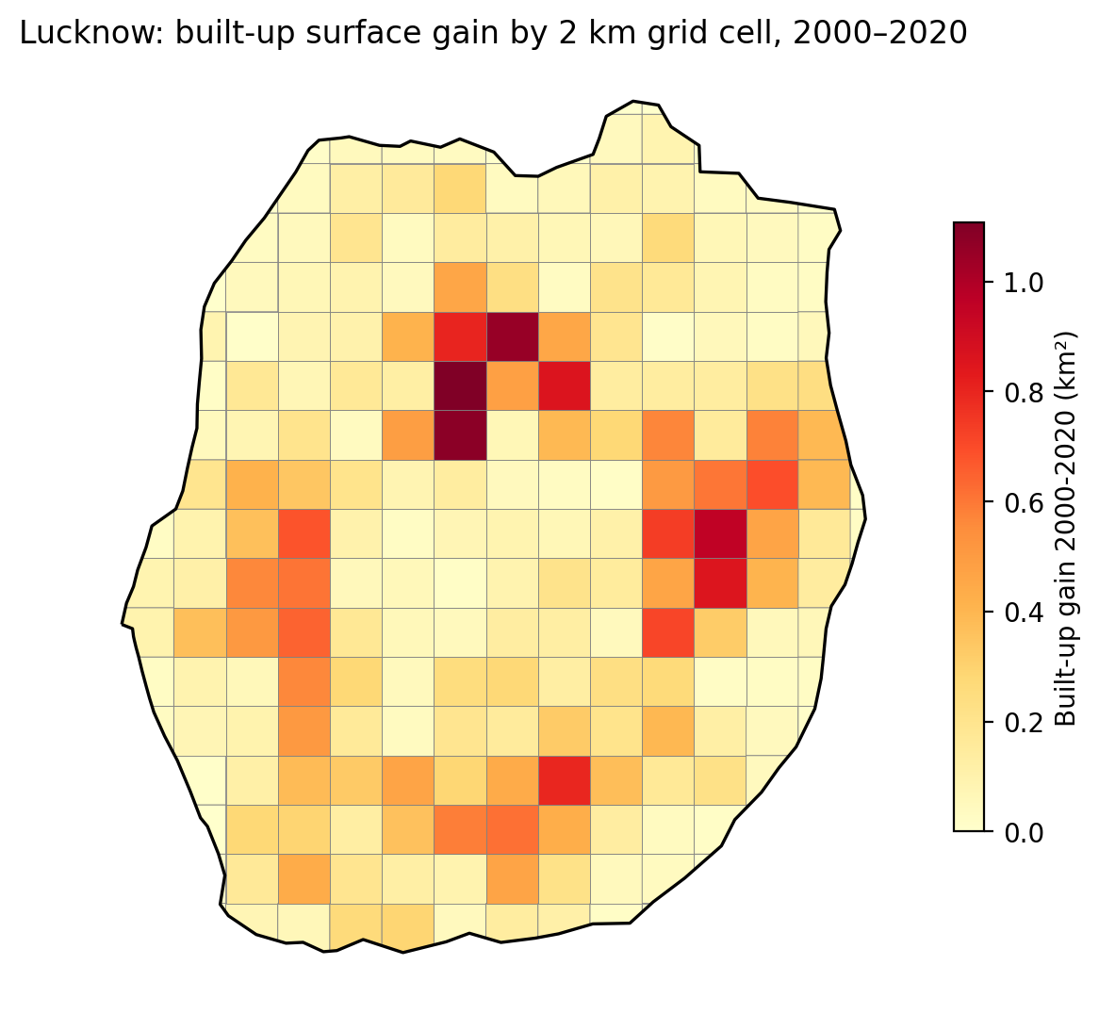
Where did built-up surface grow? 2 km grid
About 1.1 km²
largest gain in one 4 km² cell (roughly a quarter of the cell)
Largest gains: north-central and east of the city
Moderate gains: west and south, along the edge of the dense core
Built-up cover rose from 20.0% to 28.2% of the city area
The core was already built in 2000, so growth is mostly infill plus edge expansion
Notes:
Built-up surface gain from 2000 to 2020 summed in 2 km by 2 km cells inside the municipal polygon. Each grid cell is 4 km2 so the largest gain of about 1.1 km2 means roughly a quarter of the cell was newly built. The largest gains are in the north-central part and the east of the city, with moderate gains in the west and the south along the edge of the dense core. Much of the central core was already built in 2000, which suggests growth is a mix of infill and edge expansion.

Slide 18
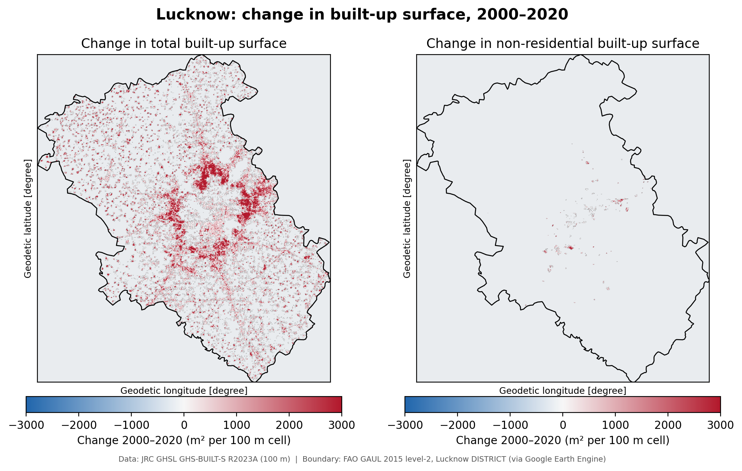
Change maps: total vs non-residential, 2000–2020
District view
Same ±3,000 m² scale on both maps
Total gain: strong around the core, scattered elsewhere
Non-residential gain: only a few clusters
District totals: +77.4 km² vs +0.89 km²
No cell lost built-up surface
Notes:
Both maps use the same minus 3,000 to plus 3,000 square metres per cell scale so the comparison is fair. Red is a gain and blue is a loss. The total map shows strong gains around the city core and edges with scattered gains across the district. The non-residential map is almost empty: gains are limited to a few clusters. For the district the totals are +77.4 km2 total versus +0.89 km2 non-residential. No cell lost built-up surface in this comparison.

Slide 19
Cell-level gain statistics: municipal area
Statistic | Total | Non-residential
Mean gain per cell (m²) | 813 | 24
Standard deviation (m²) | 1,308 | 226
Maximum gain in one cell (m²) | 8,883 | 6,808
Area of cells with gain ≥ 100 m² (km²) | 138.43 | 6.77
Area of cells with gain ≥ 1,000 m² (km²) | 72.15 | 2.06
Area of cells with gain ≥ 5,000 m² (km²) | 3.56 | 0.10
813 vs 24 m²
mean gain per 100 m cell: total vs non-residential, a ratio of about 34 to 1
138 of 277 km²
of the city area lies in cells that gained at least 100 m², so growth is widespread, but only 3.6 km² gained 5,000 m² or more per cell
Notes:
Statistics of the change in built-up surface per 100 m cell inside the municipal polygon. The mean gain per cell is 813 square metres for total built-up surface and only 24 square metres for non-residential. About 138 km2, roughly half of the 277 km2 city area, lies in cells that gained at least 100 square metres, and 72 km2 in cells that gained at least 1,000 square metres. Only 3.6 km2 of the city gained 5,000 square metres or more per cell, which marks the most intensely transformed cells.

Slide 20
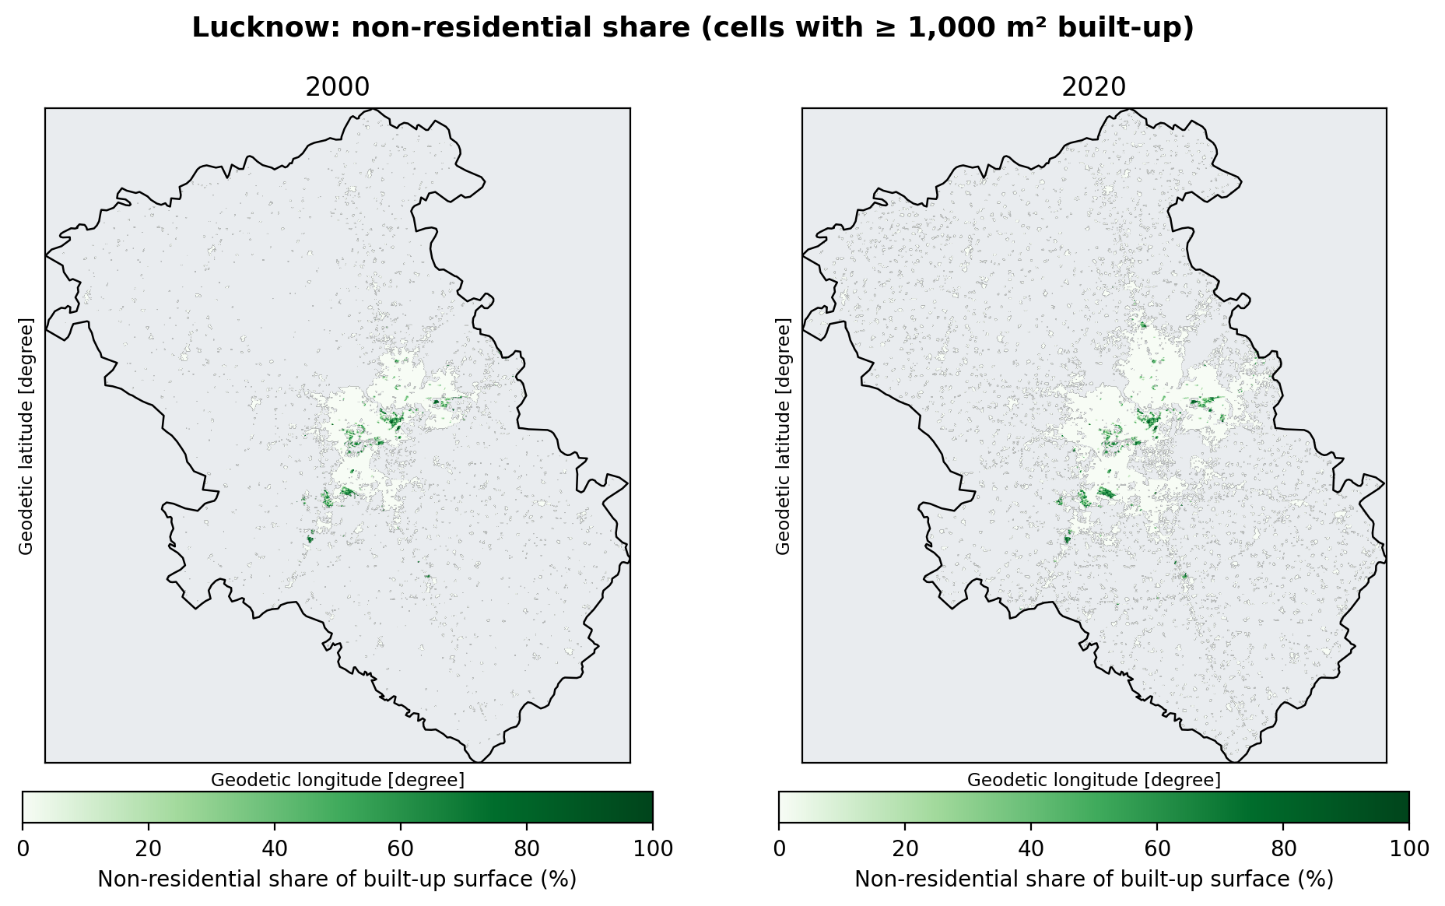
Where is non-residential surface concentrated?
District view
Cells with at least 1,000 m² built-up
Dark green = mostly non-residential
Small clusters near the centre, few outliers
Pattern changes little, 2000 to 2020
District share: 2.72% → 1.92%
Notes:
The maps show the non-residential share of built-up surface in each cell with at least 1,000 square metres of built-up surface, for 2000 and 2020, in the Lucknow district. Dark green cells are dominated by non-residential use. They form small clusters near the centre and a few outliers, and the pattern changes little between 2000 and 2020. Large non-residential complexes are likely industrial, institutional or commercial, but GHSL does not say which. In the district as a whole the non-residential share fell from 2.72 to 1.92 percent.

Slide 21
Growth is moving beyond the city limits
74% → 51%
City share of district built-up surface, 2000 → 2020
29%
of the district gain (+22.7 of +77.4 km²) fell inside the city
Outside-city values are district minus city and approximate: the two boundaries come from different sources.
Notes:
The district gain in each interval is split into the part inside the municipal polygon and the remainder, computed as district minus city. Inside the city the added area slowed to 4.3 km2 in 2015 to 2020, while outside the city it jumped to about 32.6 km2. The city share of district built-up surface fell from 74 percent in 2000 to 51 percent in 2020. The city captured only 29 percent of the district gain of 77.4 km2. The boundaries come from different sources and the runs differ slightly, so the outside figure is approximate.

Slide 22
Discussion
1
Spatial pattern
2
Temporal change
3
Total vs non-residential
Gains are widespread: about half of the city area gained at least 100 m² per cell. The strongest gains are in the north-central and eastern city and along the edge of the dense core. The core was already built in 2000, so growth is infill plus edge expansion.
Municipal built-up surface grew 55.4 → 78.1 km² (+40.9%, 1.73% per year), peaking in 2010–15 (+6.7 km²) and slowing in 2015–20 (+4.3 km²). The district added 36.8 km² in 2015–20, its largest interval, so growth moved to the periphery.
Non-residential grew +34.4% against +40.9% for total, so its share slipped from 3.46% to 3.30%. It supplied only 2.9% of new built-up surface; mean gain per cell was 24 m² against 813 m². Growth is overwhelmingly residential or other use.
138 of 277 km² gained at least 100 m² per cell
2015–20: +4.3 km² in the city, +36.8 km² in the district
Mean gain per cell: 813 m² total vs 24 m² non-residential
Notes:
Spatial pattern: gains are widespread but strongest in the north-central and eastern parts of the city, with moderate gains along the west and south edges. Temporal change: steady growth with a peak in 2010 to 2015 and slowdown in 2015 to 2020 inside the city, while the district accelerated. Total versus non-residential: both grew, total faster. Non-residential surface is a stable 3 percent of built-up surface and supplies only 2.9 percent of new built-up surface. Every statement here has a number on an earlier slide.

Slide 23
Limitations
Spatial resolution
Temporal resolution
Modelled data
100 m cells (1 ha). Small buildings and mixed use are not resolved; boundary cells are counted by their centre.
Only 5-year epochs. Yearly frames in the animation are interpolated and illustrative.
GHSL is estimated from satellite imagery. Some change may be a data effect. Zero loss means demolition is not captured.
Non-residential class
Boundaries
Validation
A predominant-use estimate, only about 3% of built-up. Residential is a residual (total minus non-residential).
City (SBM ULB) and district (FAO GAUL 2015) differ in source and date. Their results are compared, not added.
No ground validation or field survey. Runs differ slightly between outputs (district gain 77.18 vs 77.44 km², under 0.4%).
Notes:
Spatial resolution: a 100 m cell is one hectare, so small buildings and mixed land use are not resolved and boundary cells are counted by their centre. Temporal resolution: only five-year epochs exist and interpolated yearly frames are illustrative. The data are modelled from satellite imagery, so some change may reflect data and method effects, and demolition is not captured because no cell lost built-up surface. Non-residential is a predominant-use class and residential is a residual. Boundaries come from different sources. There was no ground validation. WorldPop is not used in this assignment, so there is no resolution mismatch with a population raster here.

Slide 24
Conclusions and sources
Sources
Pesaresi, M. and Politis, P. (2023): GHS-BUILT-S R2023A, European Commission JRC. doi:10.2905/9F06F36F-4B11-47EC-ABB0-4F8B7B1D72EA
Google Earth Engine: JRC/GHSL/P2023A/GHS_BUILT_S
City boundary: Indian Urban Local Body boundaries (SBM, DataMeet / ramSeraph release, CC0)
District: FAO GAUL 2015 level 2
Basemap: © OpenStreetMap contributors
Municipal built-up surface grew 55.4 → 78.1 km² (+40.9%).
1
Non-residential grew +34.4% and is only about 3% of built-up; share 3.46 → 3.30%.
2
Download Lucknow- GHSL -statistics
Gains are widespread, strongest in the north-central and eastern city.
3
Download ward statistics
Growth is shifting beyond the city: district 74.7 → 152.2 km².
4
Notes:
Conclusions: total built-up surface grew 40.9 percent inside the municipal area and doubled in the district; non-residential surface grew more slowly and stays near 3 percent; growth is moving to the periphery. Sources are listed on the right. The code notebook and the webpage link are the two submission items for Question 2.

